Slide 1

Basics of
Cloud Computing

Slide 2
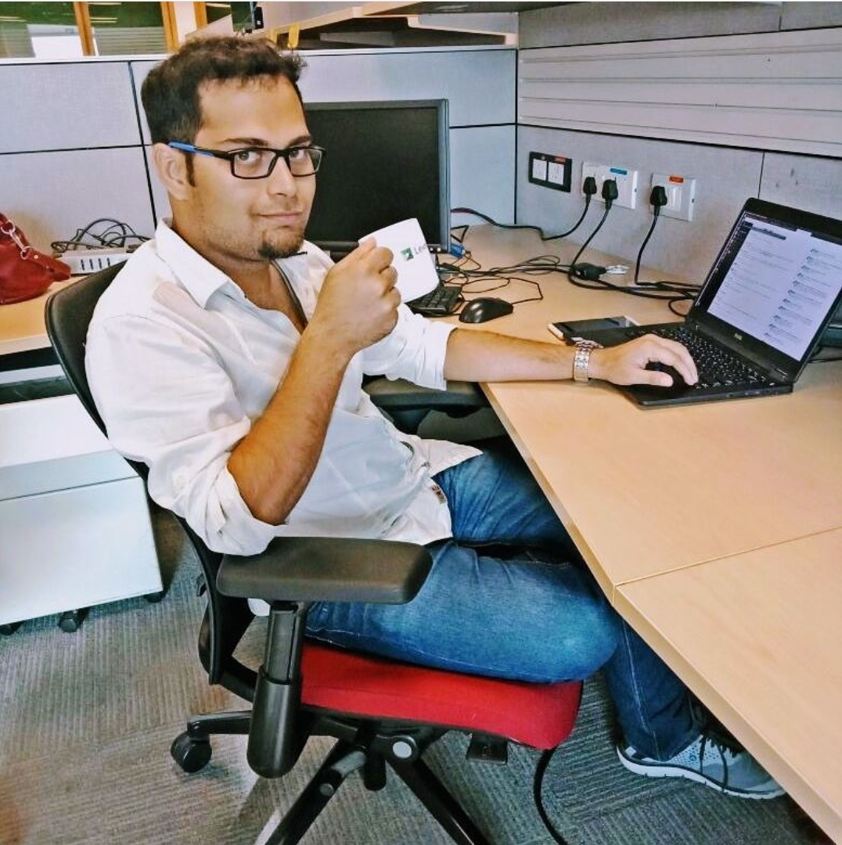
Ayan Banerjee
Software Engineer @Hyland - RnD department
Contact Details - (+91)9088-246290
Mail - ayanbanerjee.jobs@gmail.com
GitHub Url - https://github.com/ayanNullPointerEx

Slide 3
Request everyone to keep their microphones silent
In case U have any question pls write the questions in the chat box. We will discuss it at the end of presentation.

Slide 4
Feel Free to ask Questions

Slide 5
Prerequisites -
Html page - static / dynamic
Server - Web / Application server
Outcome of this session -
Basic understanding about what cloud is.

Slide 6
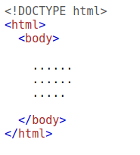
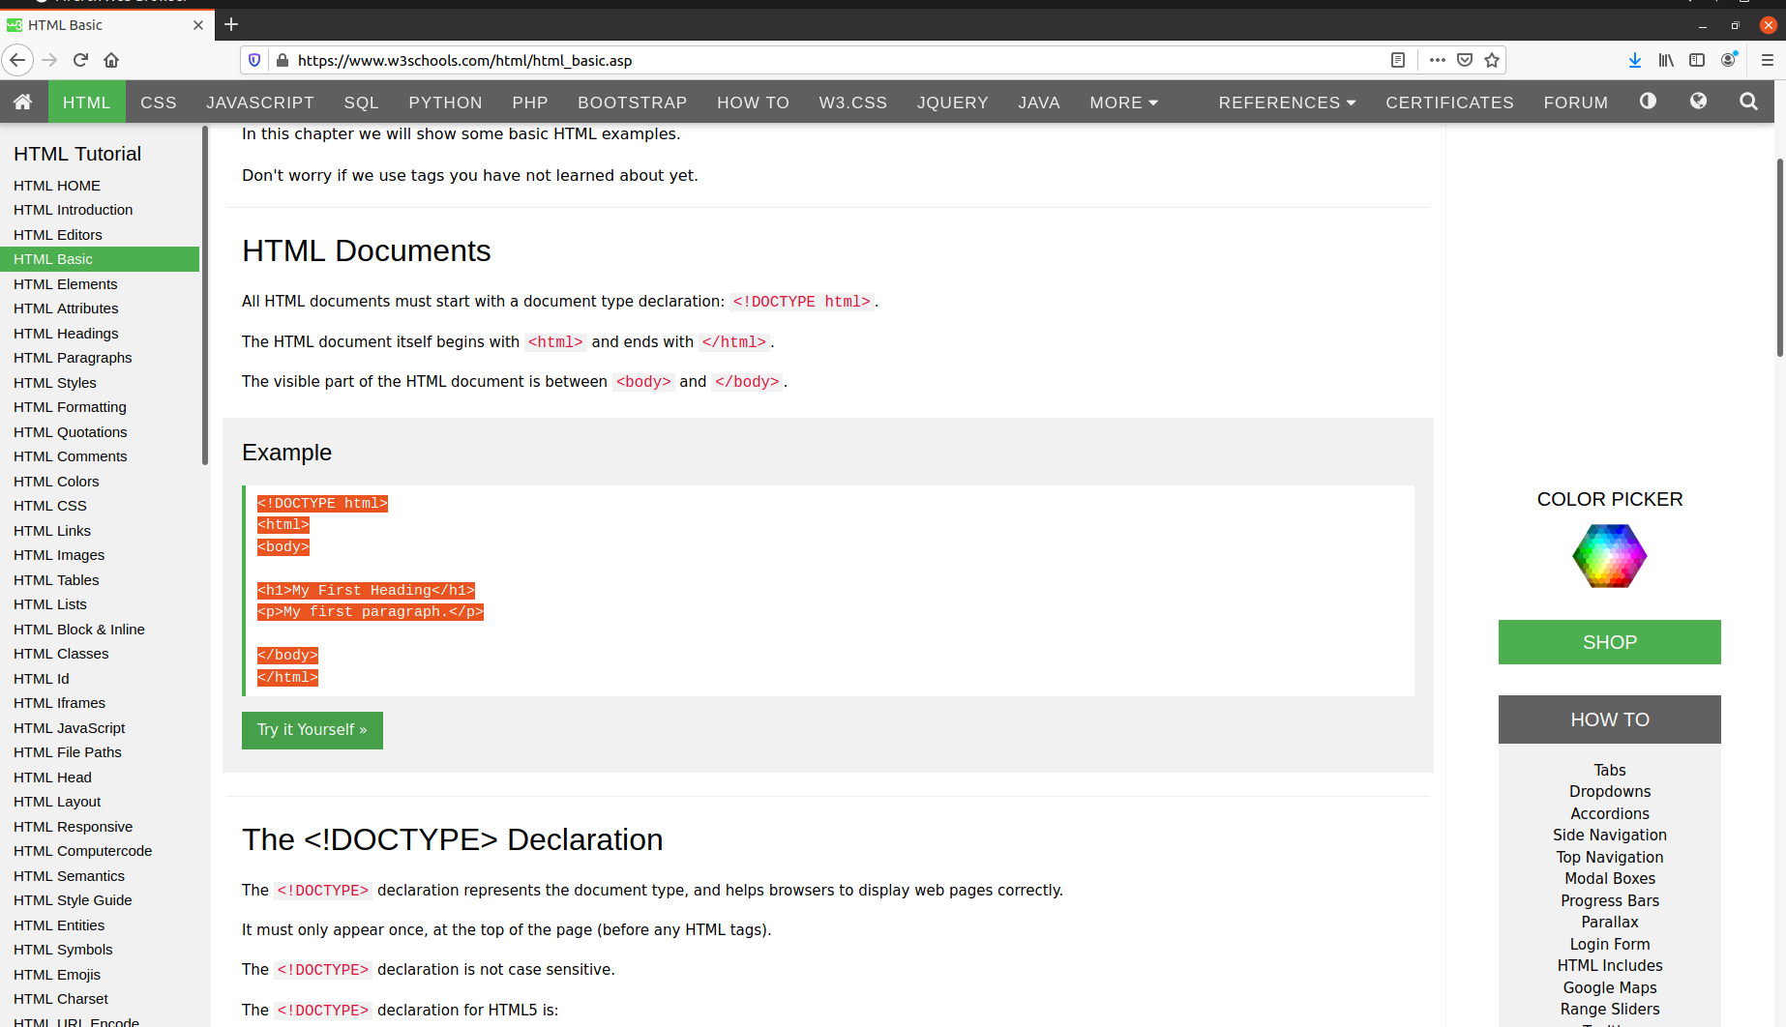
What is a HTML Page ?
<=>

Slide 7
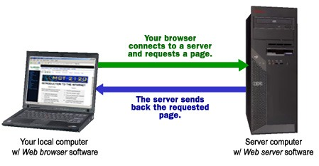
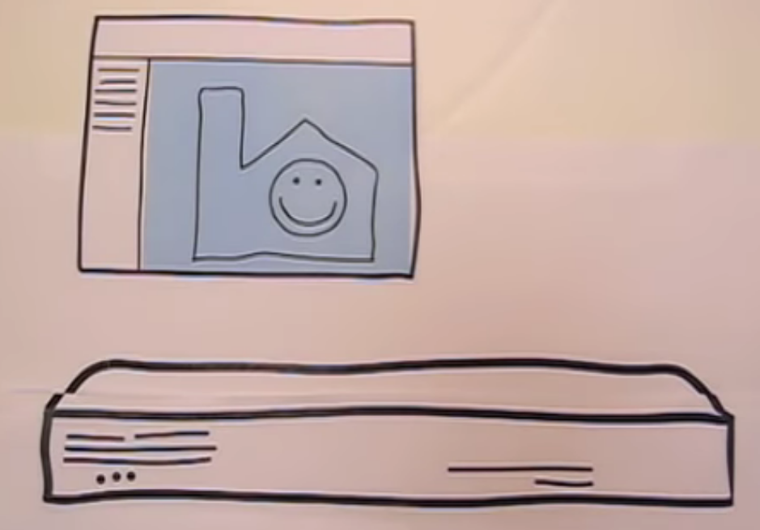
What is Server ?
A Computer - Desktop, Laptop, etc.
Install a Server application (e.x - Apache,Tomcat,IIS,etc)
Deploy the application code

Slide 8
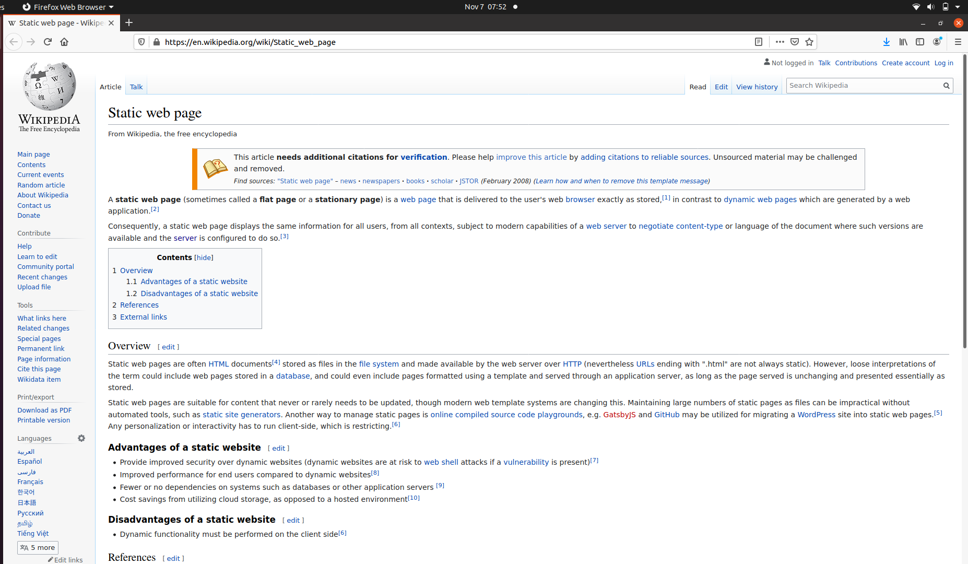
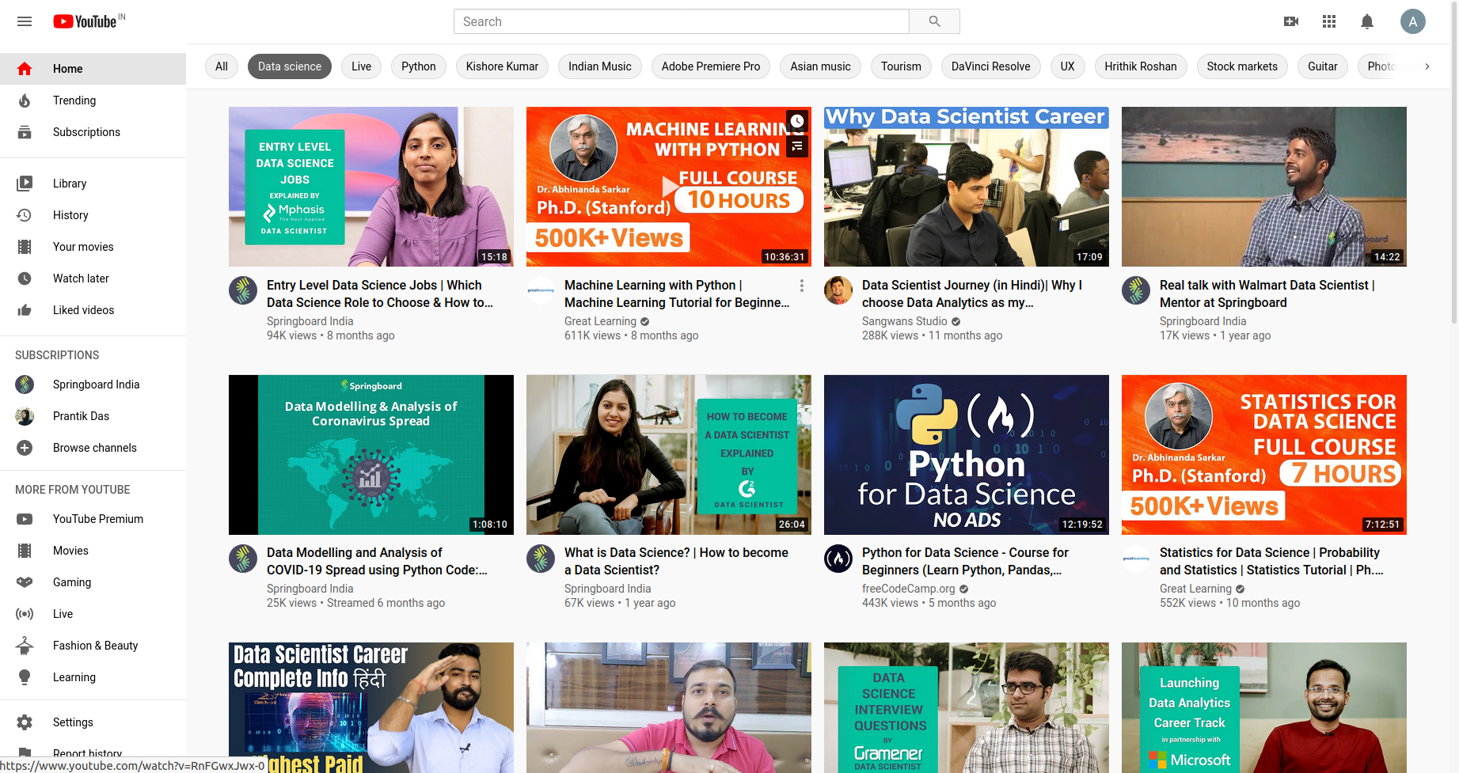
Types of Servers -
Web Server - for static resources
Application Server - dynamic websites , more interactive

Slide 9

Cloud Computing

Slide 10

Online Shopping portal Example -
Imagine 2 friends, Ayan n Sayan wants to create a online shopping portal for their business.
So where to start ??

Slide 11

I wanna host a website .. How to do ?? 🤔
Build the website, write lines of html (UI) code, application server code
Buy a computer & install server in it.
Buy a leased line (Internet) n domain.
Maintenance & troubleshooting

Slide 12
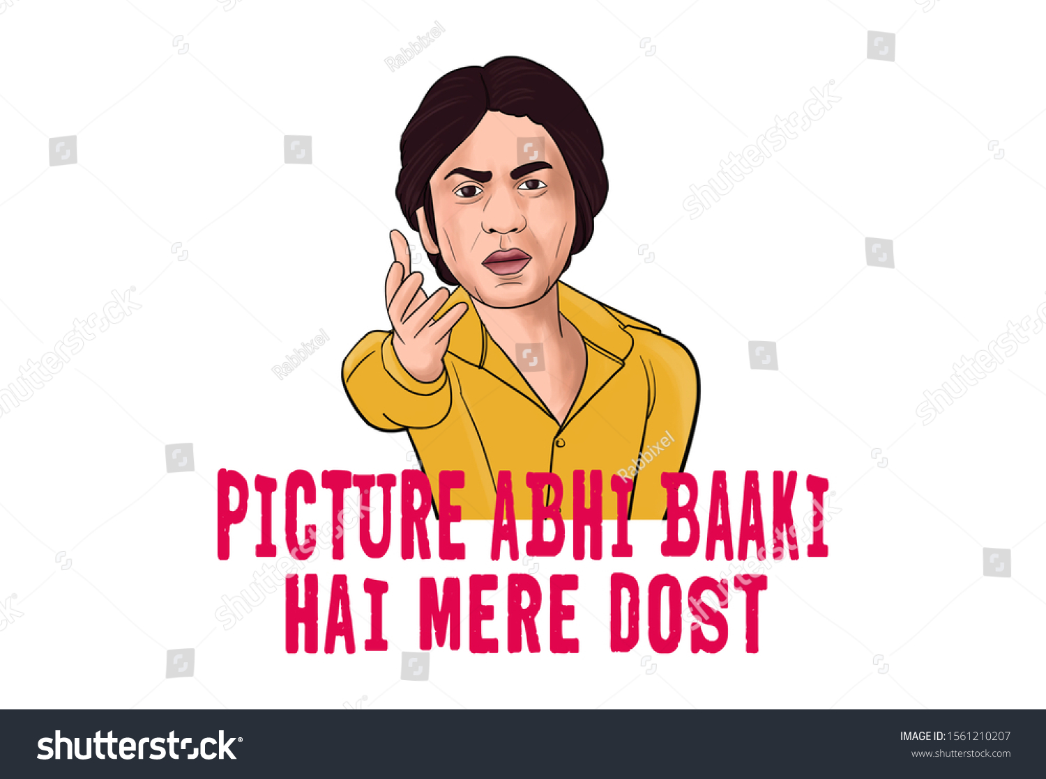
U think thats all ?
Oh Noo!! Wait..

Slide 13
Online Shopping portal Example contd. -
Ayan: A server can handle a finite amount of traffic - say 1000 requests/second.
What if we get 1500 requests ???
Sayan: Simple, we buy another computer and a router to distribute traffic.

Slide 14
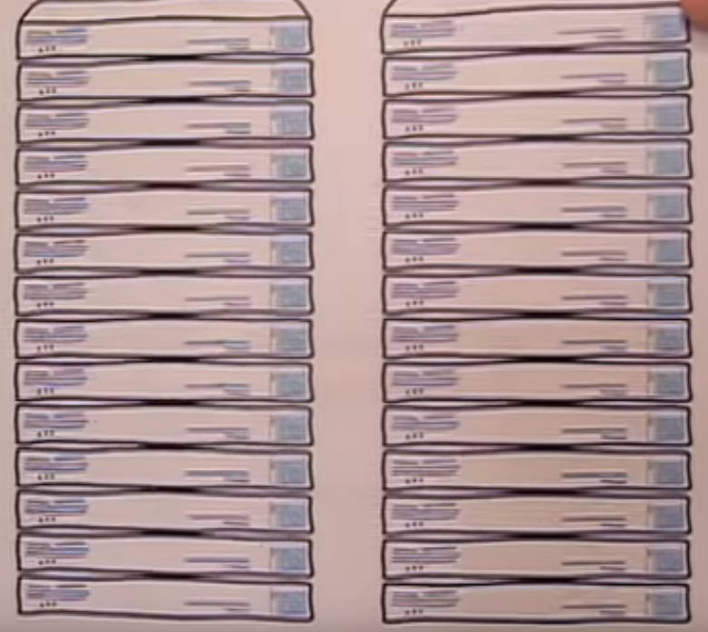
Ayan: What if we get 10 times more traffic ??
Sayan: Why buy more servers.
Ayan: Okayyy but it may cost U more than 10 Lakhs, are U sure U gonna spend that much for a small business ??
Sayan: Well I didn’t think abt that
Ayan: What if U get this load only once a year rest of the time U can manage with a single server.
Sayan: 🤔 Well I don’t know …

Slide 15
Continue ...
Ayan: Let’s assume we manage 50 new server machines. But who is gonna install all softwares / deploy the application ?
Sayan: mmm ….. 🤔
Ayan: How much time is required to host the software in all the machines and do the required networking ?
Ayan: Will the leased line broadband allow such huge amount of traffic ?
Ayan: What if the network breaks ??
Ayan: In case of any issue how am I alone gonna manage the entire architecture ?

Slide 16

Sayan: Hmmm ……… really too much

Slide 17

Well, what if I say Cloud has solution to all the problems !!

Slide 18
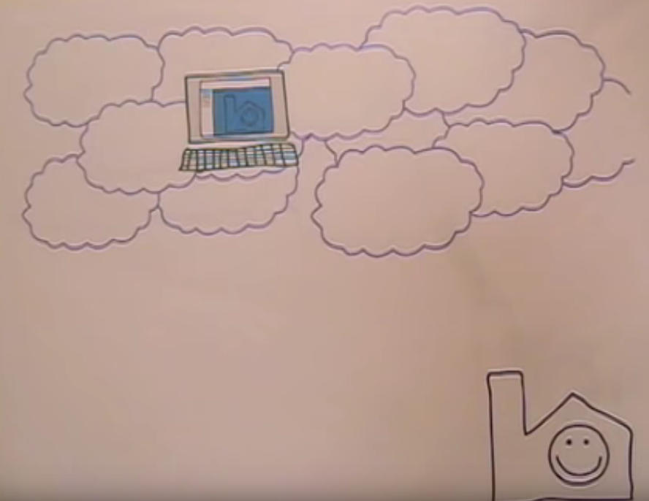
So what is CLOUD ?? “Cloud is about how you do computing, not where you do computing," goes a popular refrain in the domain of modern computing.
Imagine they have another friend named - Cloud. They give their code to him, n he takes care of everything else.
He creates a server installs all required softwares for them and deploys the code in server.
Oh I forget to tell, Mr. Cloud has supernatural abilities. He can create servers real quick like he can spin up 100 servers in 1 min n deploy code. N he uses a network line that never goes down.
He is also too kind; he does n’t charge the entire cost of all the machines. Rather, he charges on a rental basis.

Slide 19
Move the app from local system to machines stored in cloud provider data centre.

Slide 20
Salient Features of Coud -
Autoscaling
Automatic setup
Automatic load balancing
Distributed globally

Slide 21
Autoscaling

Slide 22
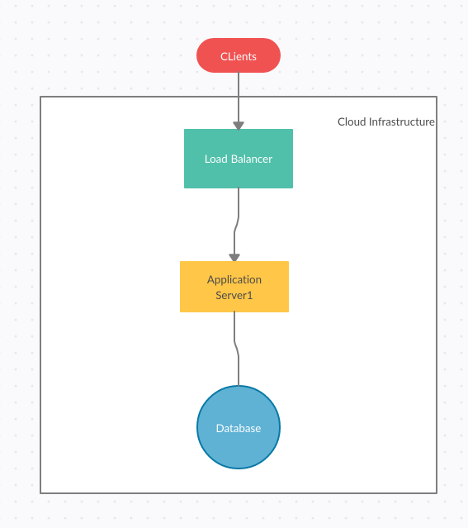
Load = (Expected CPU Load) / (Max CPU Load) * 100
Load > 80%,span a new server

Slide 23
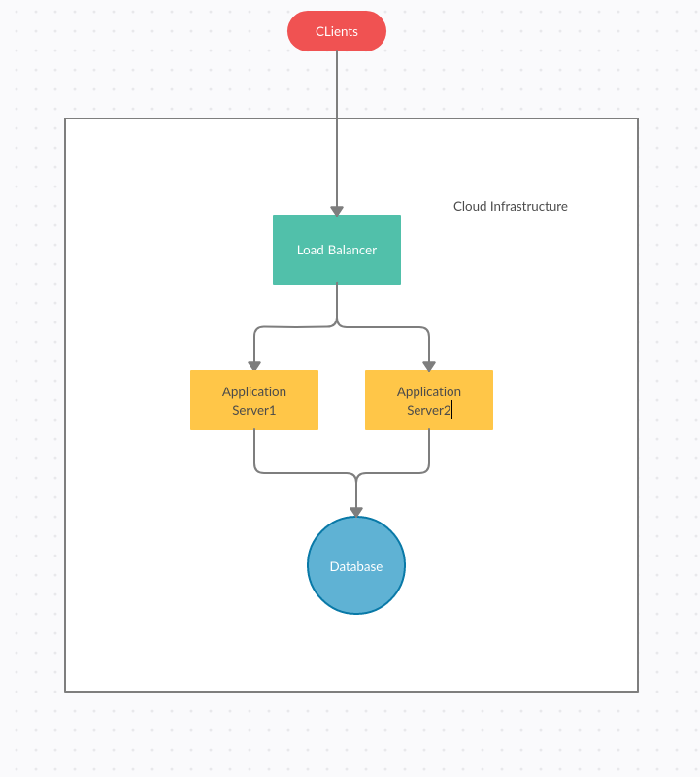

Slide 24
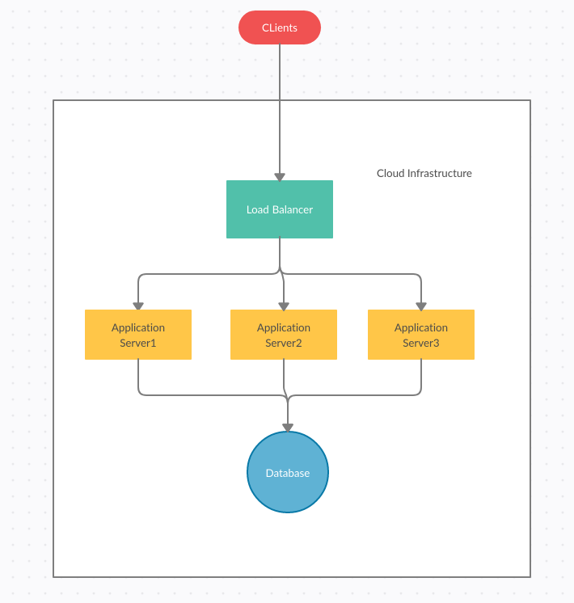

Slide 25
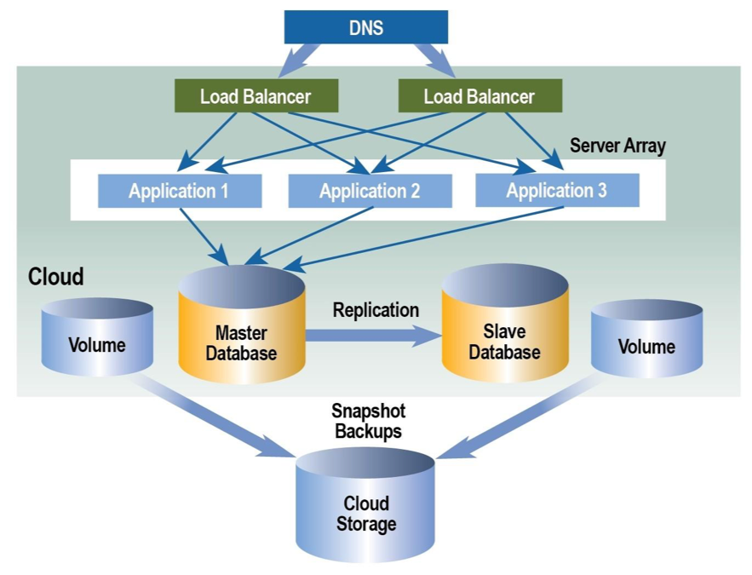
Automatic Load balancing -

Slide 26
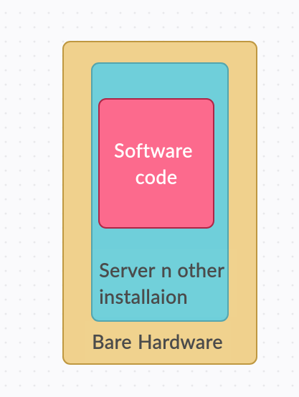
Automatic Setup
Devops engineers provides a script.
This script lists down softwares to be installed n other setup activity.
The cloud management tool executes the statements.
This script is executed automatically when a new server is instantiated.

Slide 27
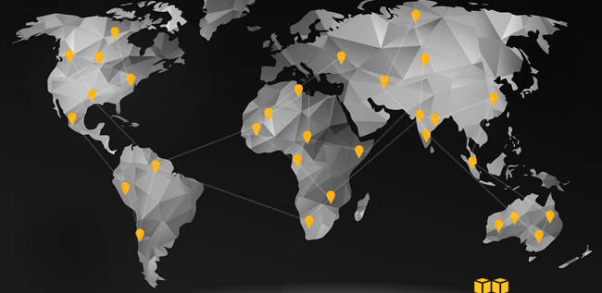
Distributed worldwide

Slide 28


Slide 29
Cloud Example -
Pokemon GO -
Developed in cloud
There was a enormous surge of traffic.
It had 50 times more traffic than it was planned for.
It was able to handle the entire load.
That’s the MAGIC of Cloud

Slide 30
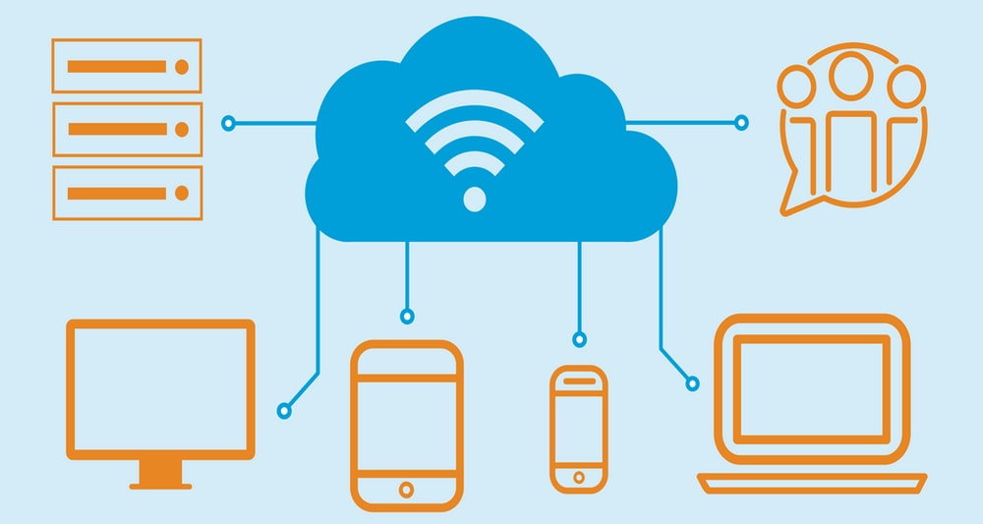
Benefits of cloud computing -
Zero Capital expense
Massive scaling ability
Auto-scaling
Capability to scale up n down rapidly
99.9 % availability
Available from any corner of the world
Zero downtime
Pay as per use
No headache abt maintenance,networking
Easier Troubleshooting

Slide 31
Cloud Providers -
Amazon Web Service - AWS
Microsoft Azure
Google Cloud Platform - GCP
etc.

Slide 32
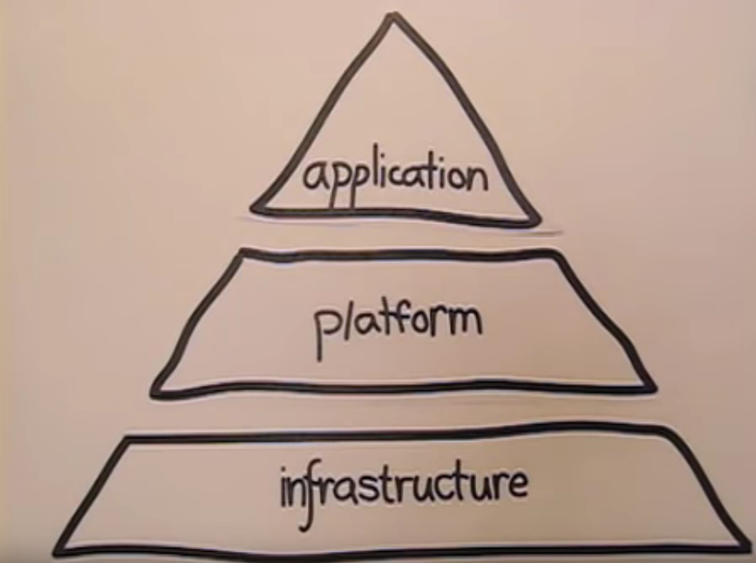
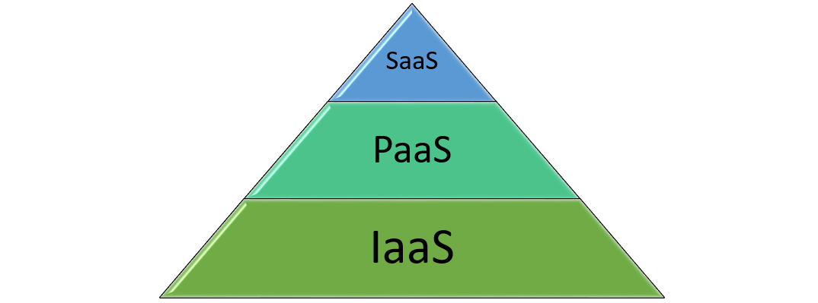
Cloud Service Models -

Slide 33
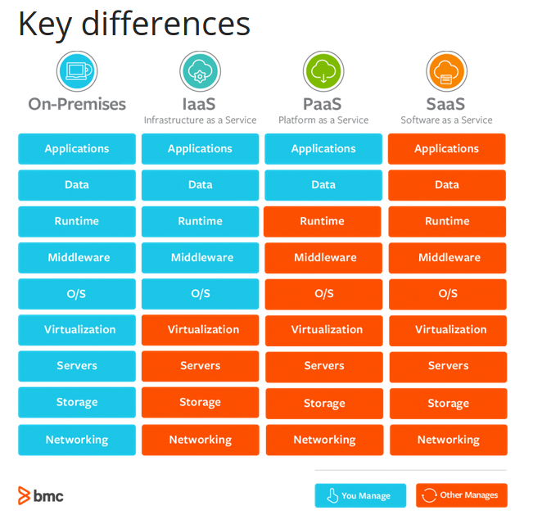

Slide 34
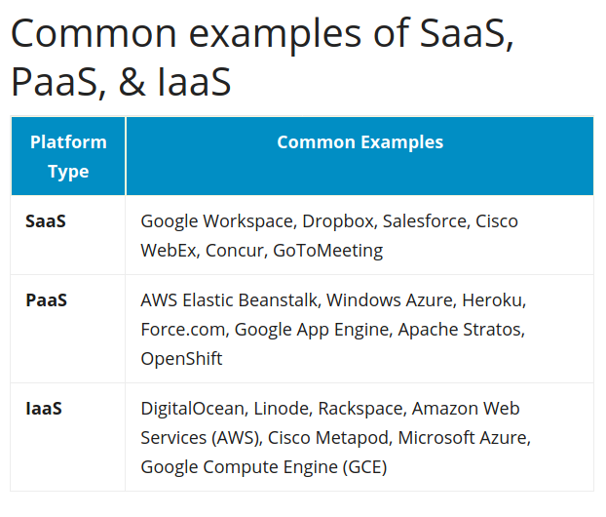

Slide 35


Slide 36
Microservices

Slide 37
Shopping Portal Example -
Consider the shopping portal application takes 10 units of CPU & 10 units of memory. (10 Threads)
It’s a heavy application having multiple functions n logic to cater all the domains.
Imagine during a festive season there’s a huge influx of traffic, mostly customers purchasing products. So the entire application becomes busy with order management. However, a simple user addition may not have any relation with order management, but it still will face heat of server overload.
Q: Do we really need such huge codebase for only order management ???
Q: What purpose does order management function/code serve in adding a user ???
Domains –
User Management
Identity Management
Catalog
Order management
Financial management
We know that more code increases memory consumption and makes the application heavy. Can we somehow reduce the size ???

Slide 38
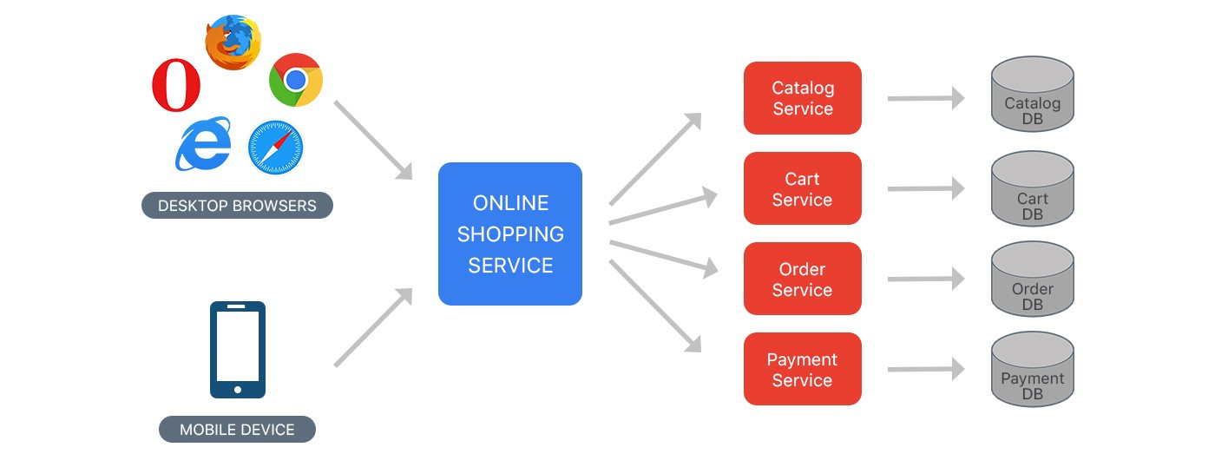
Microservices -
Breaking a monolith application into smaller services based on domains.
The microservices communicate among them via REST calls.
Since the size of each service is small it will consume less resources. In other words, it each microservice will only consume what’s required, no extra.

Slide 39
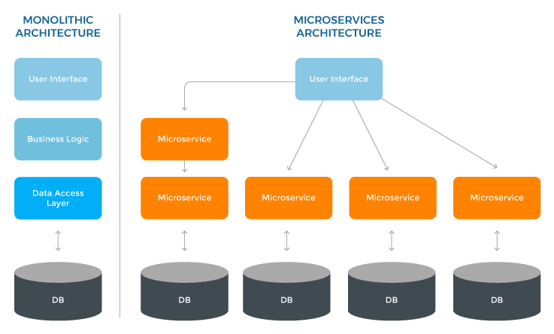
Monolith vs Microservices -

Slide 40
Microservices on Cloud -
We can host microservices on cloud nodes. Coming back to our shopping portal example, we can have different microservices like – Ordering management service, user management service, etc. Each deployed on separate cloud nodes.
When there is increase in purchases then the order management service can be auto-scaled to cater the required traffic. However, the user management node need not be scaled. If a user tries to update user details, then it’s a separate microservice. The high traffic load on ordering will not affect him.

Slide 41
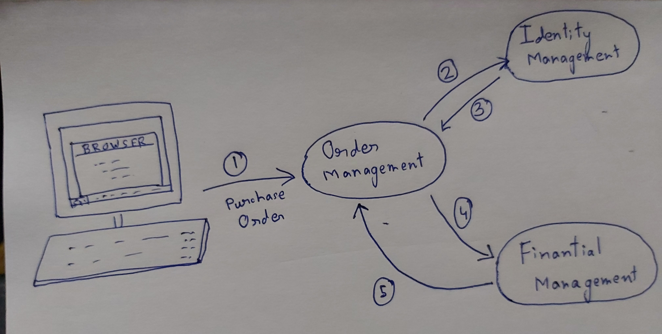
Overview of Microservices Architecture -

Slide 42
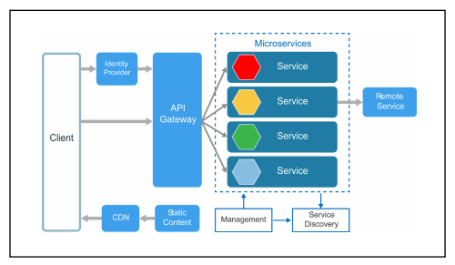
Deeper Dive into Microservice Architecture -
API Gateway
Identity Provider
Service Discovery
CDN – GitHub
Management

Slide 43

Cheers !!...... We completed part 2

Slide 44

an important tool for microservices

Slide 45
Why Docker ?
To create an application, we need to
Install software
Setup environmental properties
Configure all of them
provide all required libraries
Finally, write application code
Walking through all the steps for one time is fine. Imagine doing it multiple times.
How about automating them via script ?? … Wait !! … U have to write a lot of script. What if the software U gonna install already exists or there’s a conflicting configuration in the host machine with our configuration ?
Imagine a virtual machine on which U can perform all activities and then save it. Next time U need to setup the application U just copy the VM in the host machine n run it.. Well that’s what docker does.

Slide 46
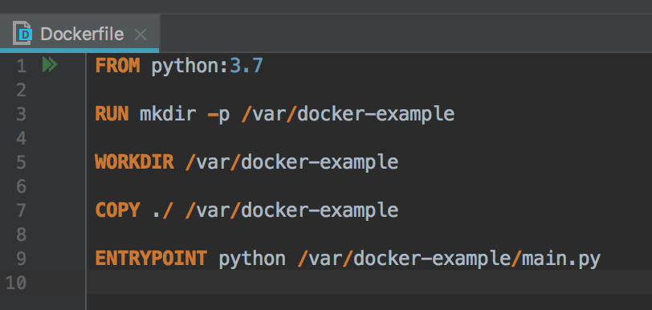
Docker – a lightweight virtual machine
Lighter than a VM.
We can store docker state as docker images.
We can share the docker image n run it on any machine we need.
Its doesn’t mess with software in the host system.

Slide 47
Confluence of docker microservices & cloud
The Final Chapter

Slide 48
Overall scenario -
Divide the Shopping portal into domains.
Write microservices for each domain in local system
Package the microservice in docker image.
Deploy each microservice in cloud nodes.
Note: Whenever the cloud senses that there's huge traffic in a particular node then it automatically spans up a new instance deploys the docker image on the new node. Since the docker image can be easily deployed on a node the cloud provider can automatically deploy it. That’s how auto-scaling works.

Slide 49
Questions !!
Queries !!
Confusion ??
Feel free & ask

Slide 50
- Thanks -

Slide 51

Contact Details
Ayan Banerjee
Contact Details - (+91)9088-246290
Mail - ayanbanerjee.jobs@gmail.com
GitHub Url - https://github.com/ayanNullPointerEx

